Slide 1
Planit!
Get Stuff Done
Planit.proj6.com
Beth Van Belle Devin Gleason-Lambert Alberto Beltran
Notes:
We're creating a web based tool that simplifies planning your projects, and scheduling your time so that you stay motivated to finish.
Introduce the team

Slide 2
Proposal Recap
Objectives
Tools List
Time Schedule
Grading Scheme
Project Retrospective
Planit! Demo
Notes:
Our team objectives are .. .

Slide 3
Objectives
Team
Real World Software Development Process
Object-Oriented Analysis and Design
Remote/Local, Individual/Group Project Collaboration
Albert
User Interface Design
Learn Visual Studio / C#
Beth
Use C# in a Real Project
Implement a Group Project
Devin
Object-Oriented Implementation
.NET Stack
Notes:
<Devin Objectives, 4>
My objectives for the project were pretty simple, I wanted to create software that wouldn’t be thrown away at the end of the semester.
<Next/>
Next I want to build on my knowledge of object orientation, because I believe in the methodology and my plan is to continue using it after college,
<Next/>
And last I want to learn and use the .NET stack because it’s a qualification I want based on the job searching I have done,
And honestly I just don’t want to work with open source software
</Devin Objectives, 4>

Slide 4









Tools List
Notes:
As I had said previously a personal objective for me was to learn the .NET Stack
<Next>
and as you can see we list C#, Visual Studio, and .NET
<Next>
for the front end we plan on using JavaScript and JQuery for visually appealing dynamic web pages,
<Next>
our backend following the Microsoft stack will be SQL Server,
<Next>
and last for design we plan on using Dreamweaver for well laid out pages.
<Next>
Oh and lets not forgot Pizza and Google
</Devin Tools List, 14>
Beth

Slide 5
















Notes:
As I had said previously a personal objective for me was to learn the .NET Stack
<Next>
and as you can see we list C#, Visual Studio, and .NET
<Next>
for the front end we plan on using JavaScript and JQuery for visually appealing dynamic web pages,
<Next>
our backend following the Microsoft stack will be SQL Server,
<Next>
and last for design we plan on using Dreamweaver for well laid out pages.
<Next>
Oh and lets not forgot Pizza and Google
</Devin Tools List, 14>
Beth

Slide 6
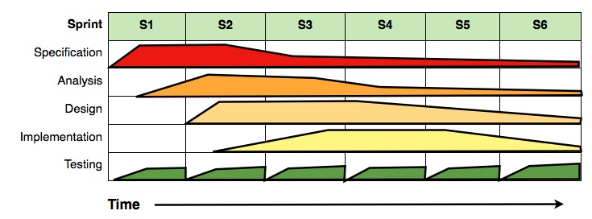
Time Schedule
Notes:
workflow chart - This work has been released into the public domain by its author, Dutchguilder at the projectname project. This applies worldwide.
2 week sprints

Slide 7
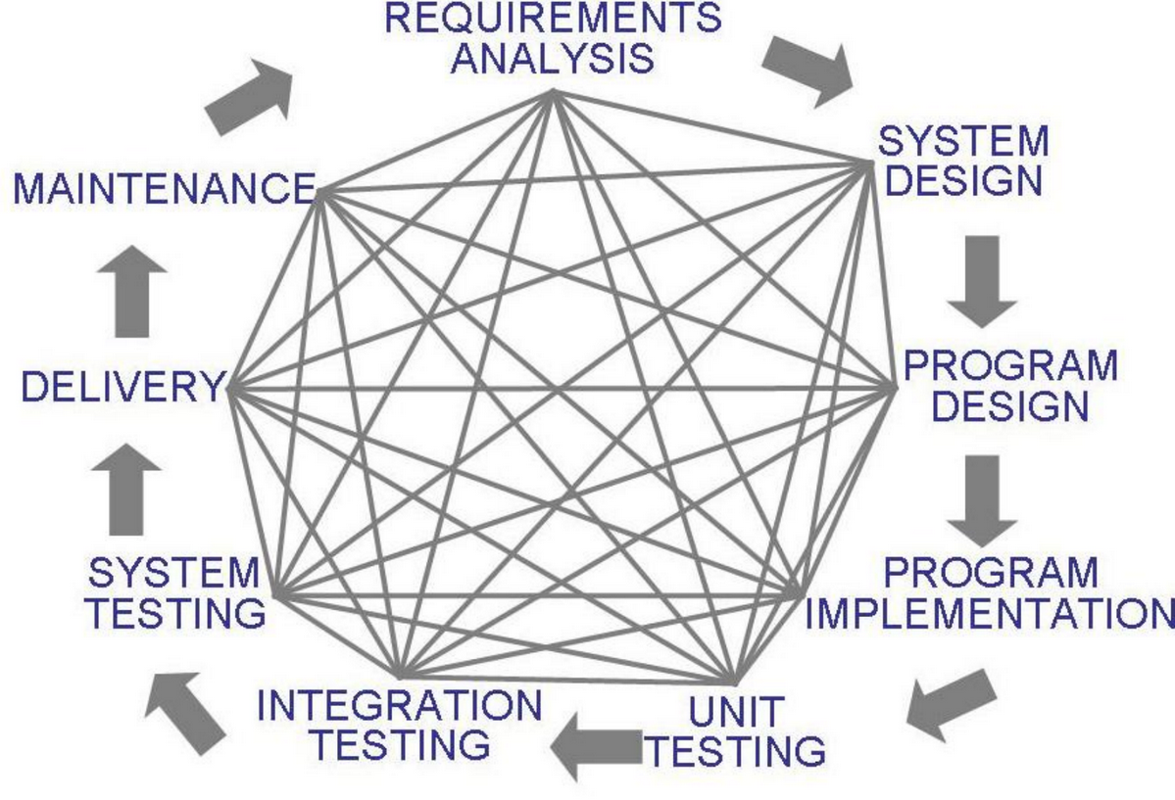
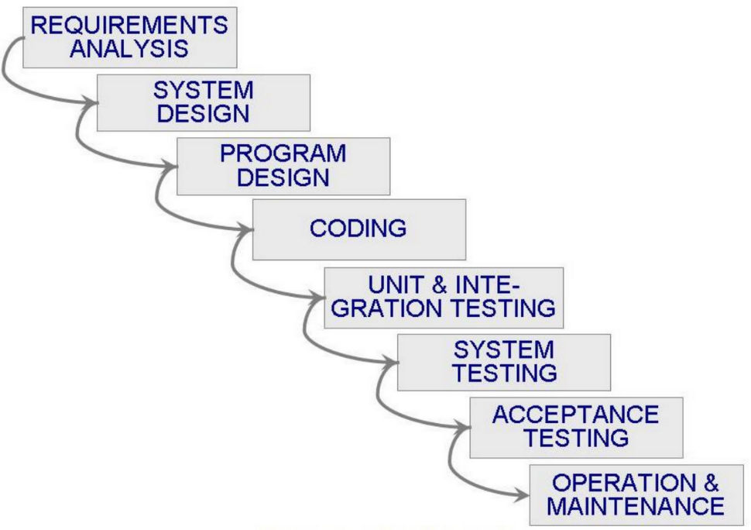
Workflow
On some level we expected.
What happened.
Notes:
workflow chart - This work has been released into the public domain by its author, Dutchguilder at the projectname project. This applies worldwide.
2 week sprints

Slide 8
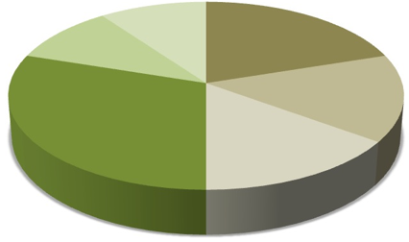
Grading Scheme
10%
20%
10%
15%
30%
15%
Notes:
We assigned specification 20% because we felt it was one of the most important parts of our project and considering we all took the software engineering track we were able to understand its importance.
<Next/>
Following up with analysis we assigned it a slightly smaller number because we didn’t feel it was as important as specifications but at the same time we felt pulling out our classes and having a good understanding of the functional flow was important for scalability and maintainability in later workflows.
<Next/>
Design was given the same level of effort as analysis because at this point we will have already spent half of our time on planning, so continuing to make sure we keep on track and work on our design before implementation seemed appropriate.
<Next/>
Implementation came in at 30%. Although the largest individual assignment, we have still assigned the majority of the project to planning.
<Next/>
Documentation has earned it's self 10% because as a real world software experience we understand that in order for a group to function properly, we can’t be wasting our time trying to understand what our colleague’s code is supposed to do.
<Next/>
And finally we have assigned our presentation 10% because our goal is to not just to deliver a piece of software but deliver a quality and engaging product presentation.

Slide 9
Retrospective
Project Framework
Doing the first walkthrough of deploying to Azure
The GIT Bash Learning curve - Living in GITHub and working in GIT
Using JQuery plugins
Integrating JQuery Plugin into MVC/Razor/Html
No change is a Stand alone change

Slide 10
Project Framework
View
.NET Framework
ASP.NET
MVC 5
Controller
Project Business Layer
Project Data Layer
Entity Framework
Database
MS SQL Azure

Slide 11
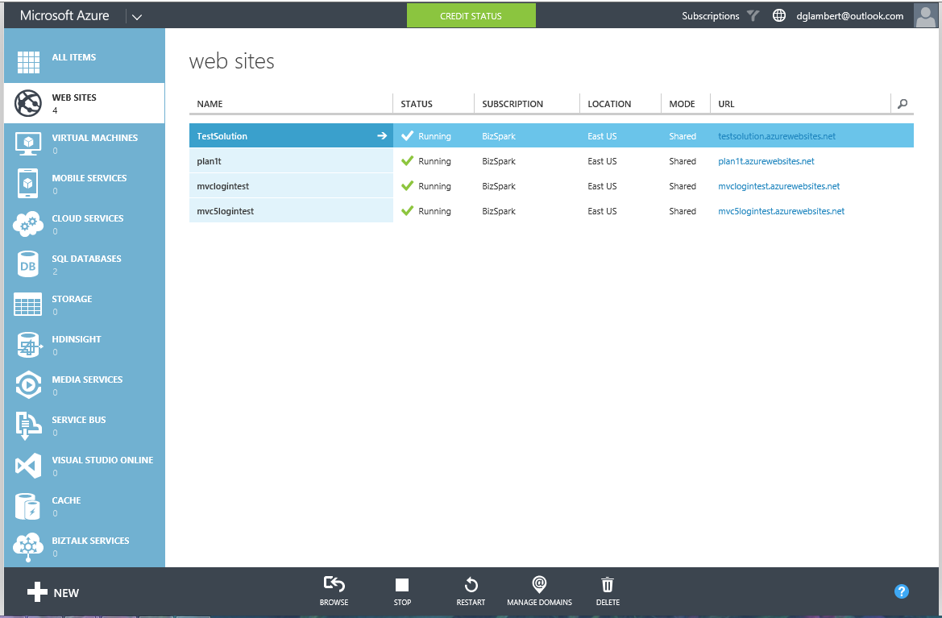
Doing the first walkthrough of deploying to Azure

Slide 12
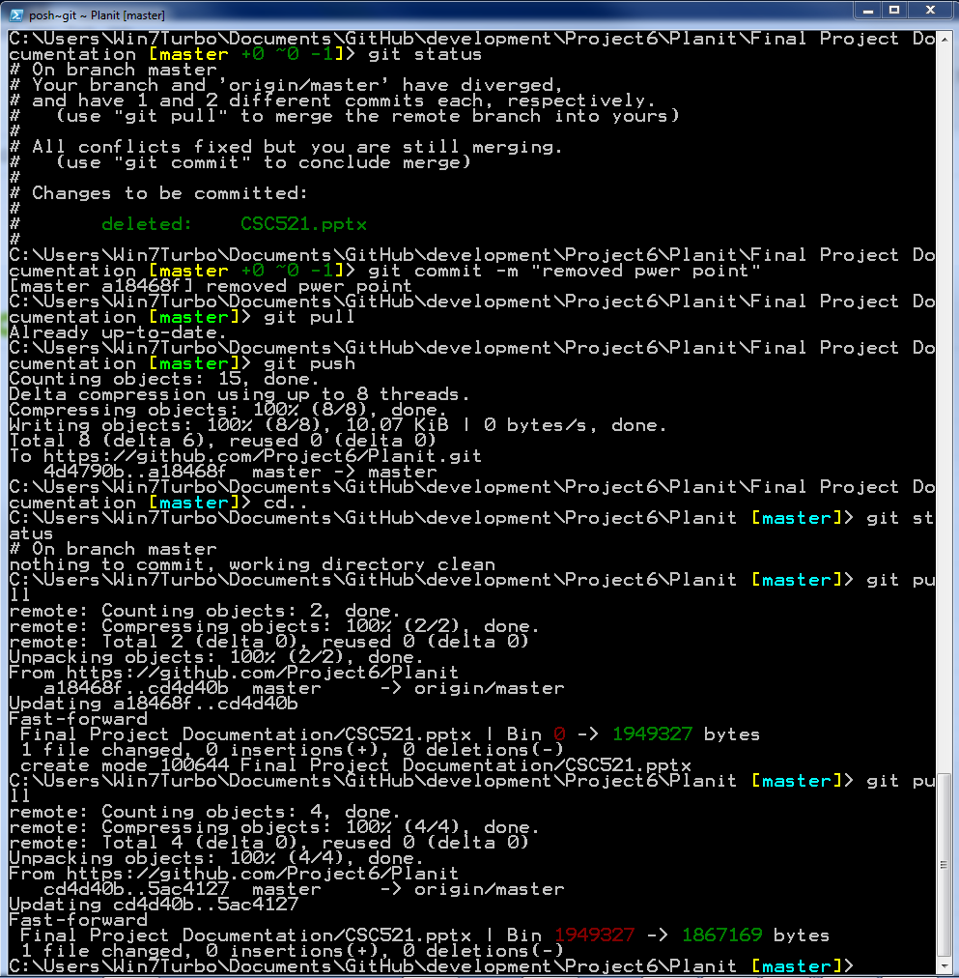
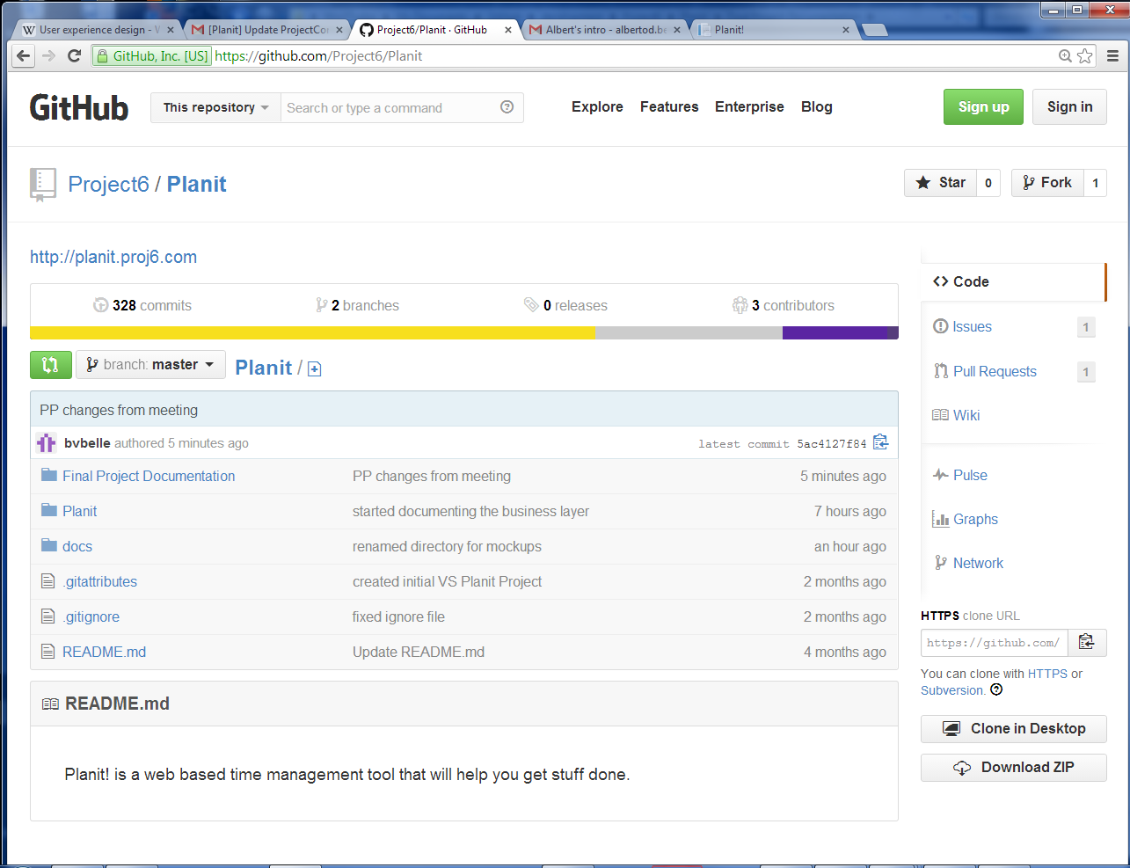
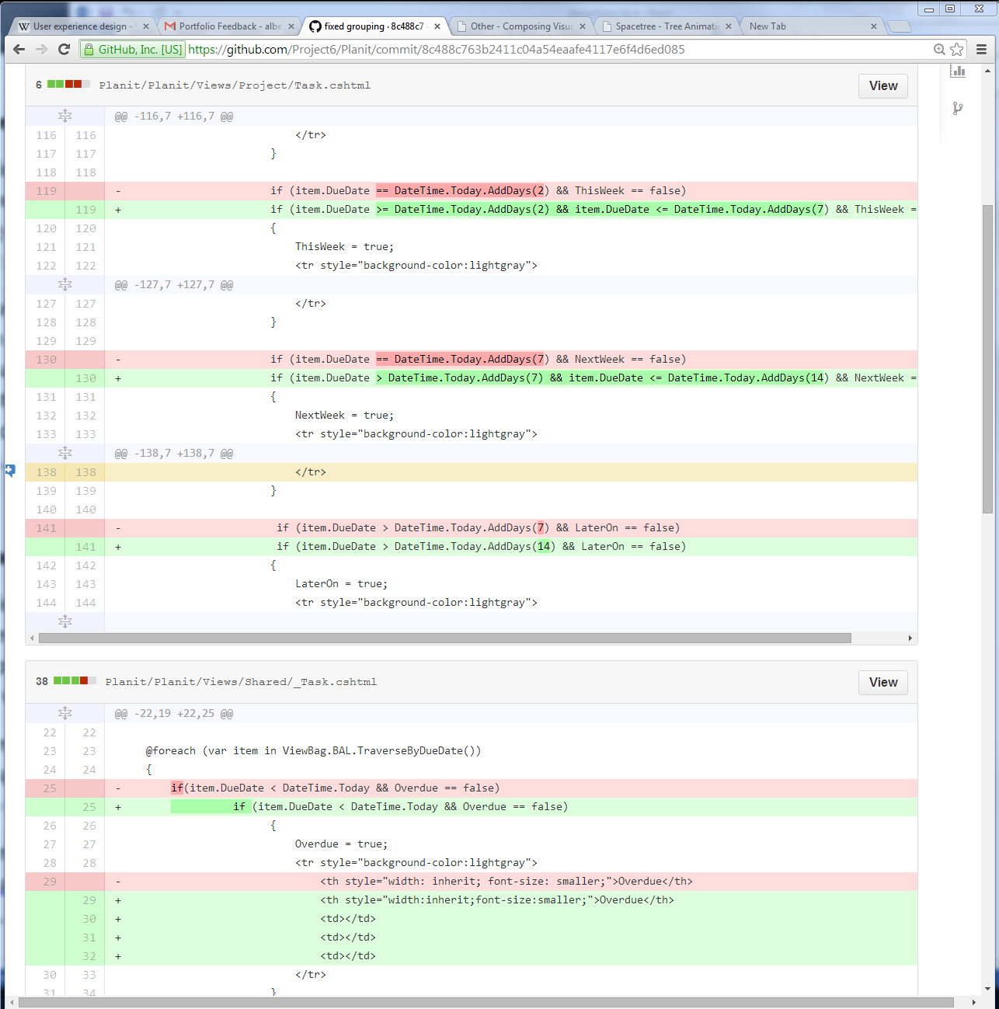
The GIT Bash Learning curve Living in GITHub and working in GIT

Slide 13
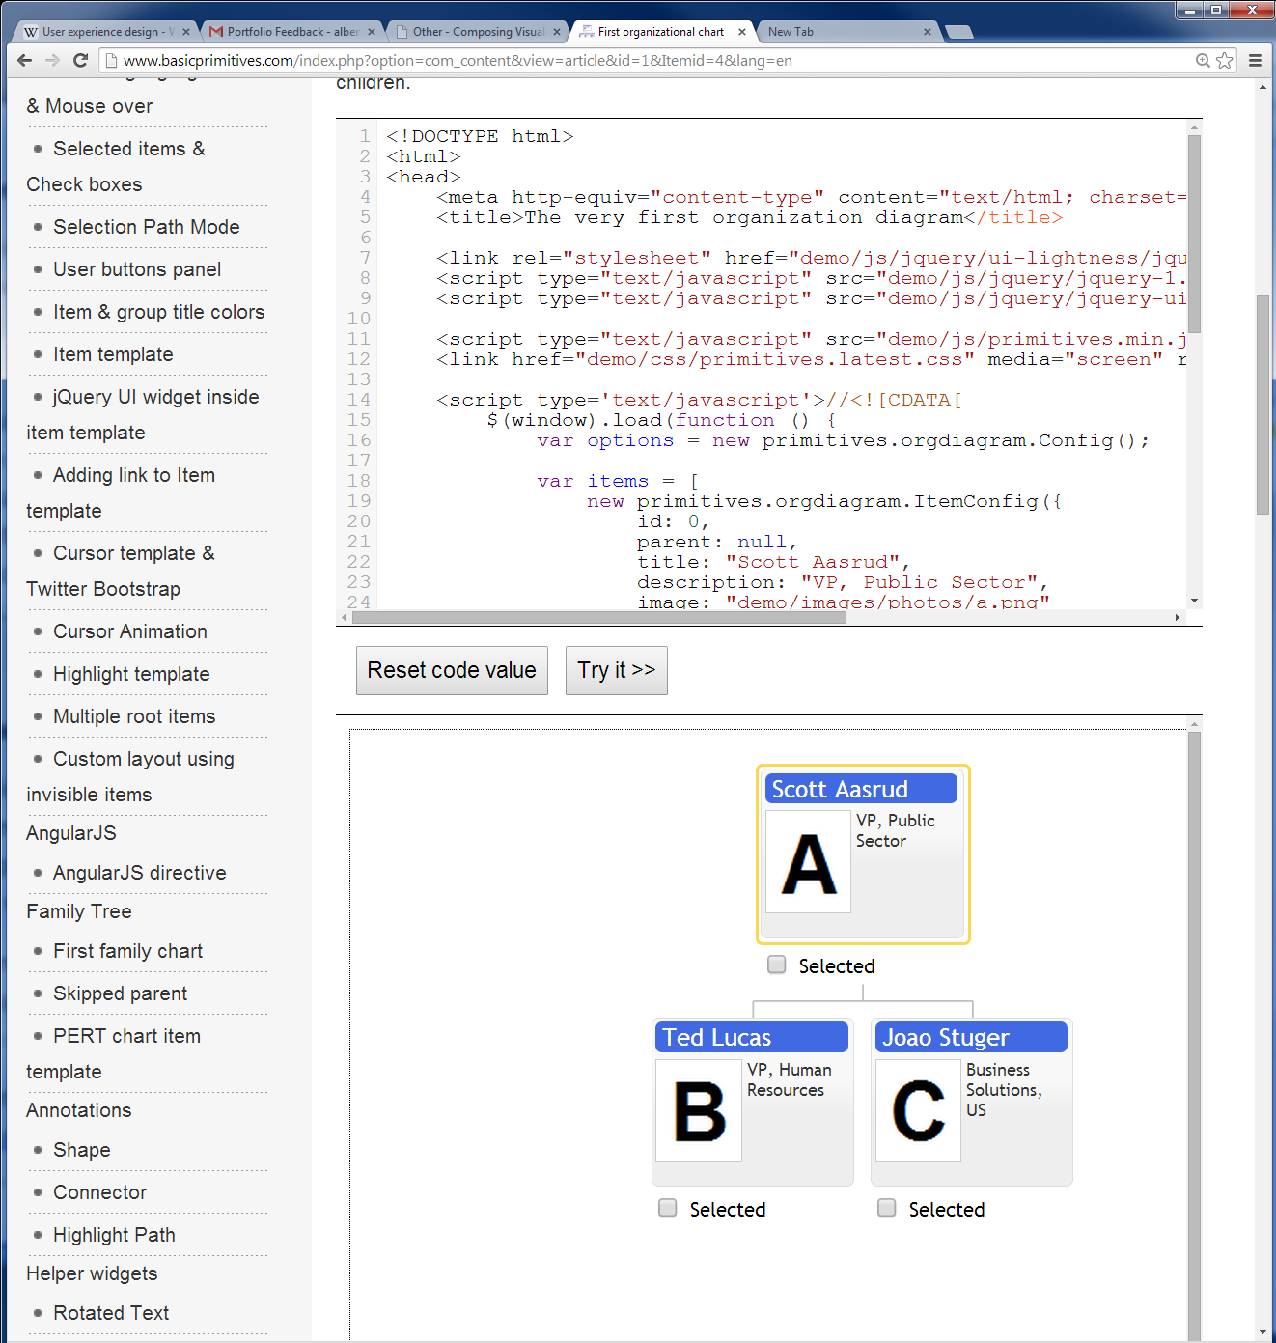
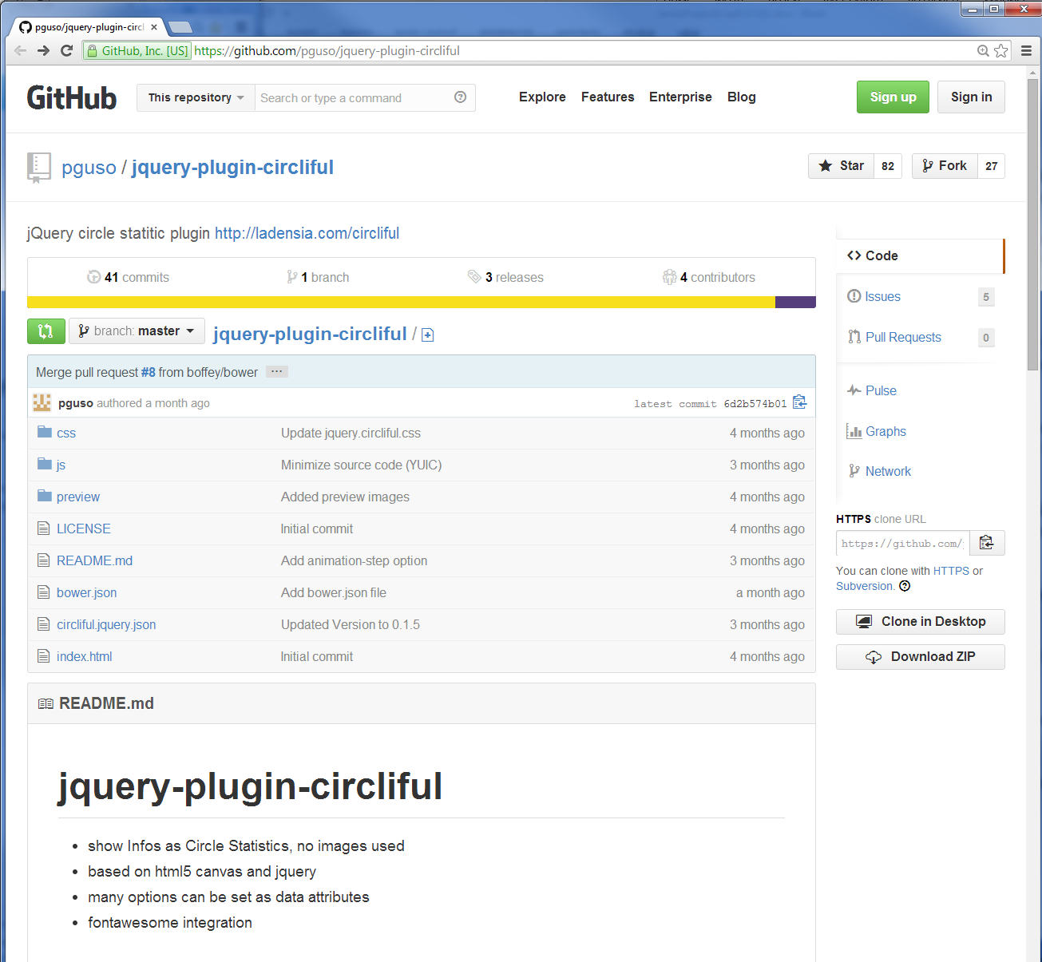
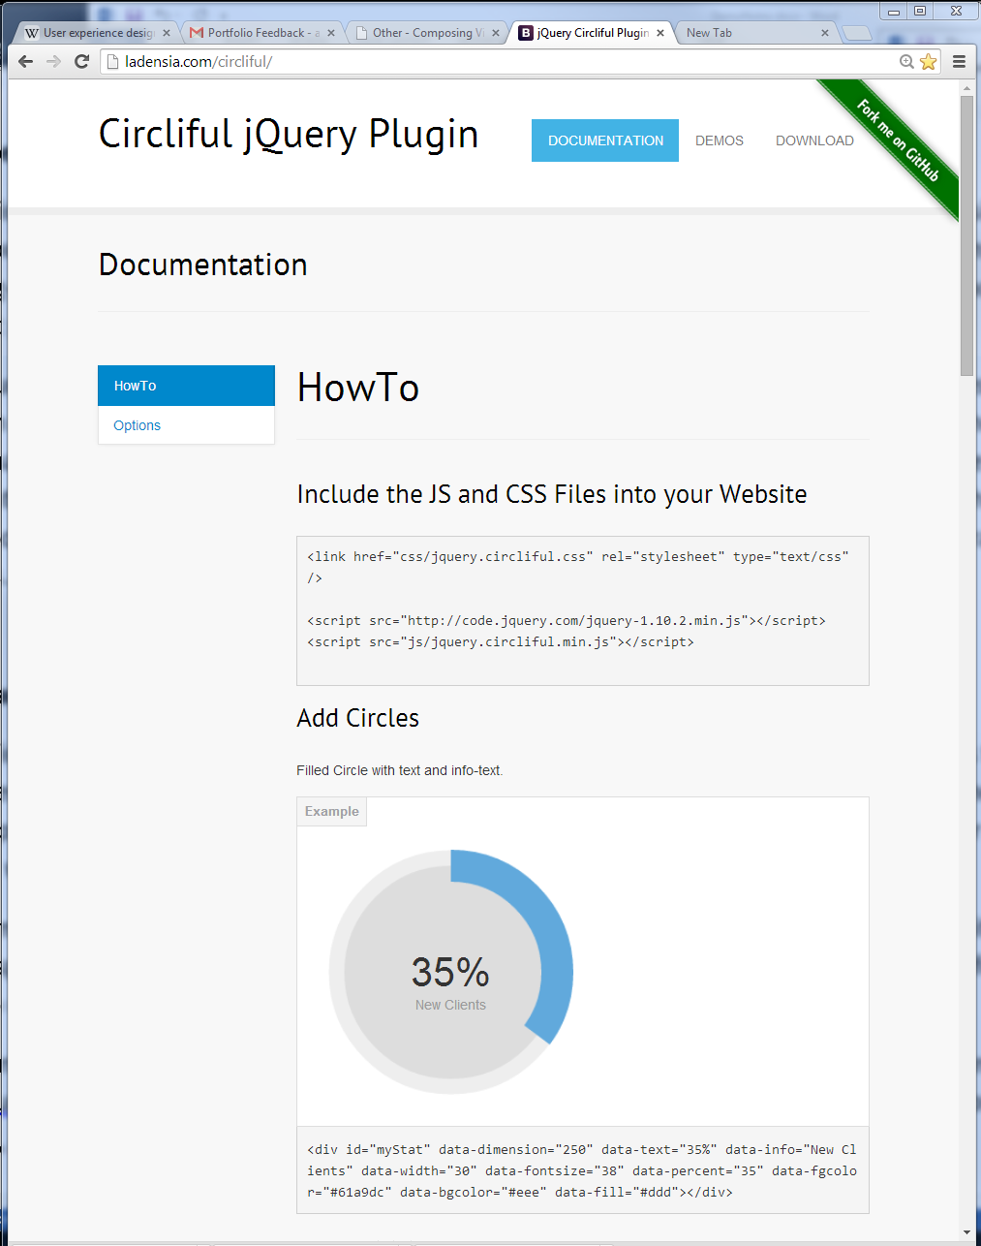
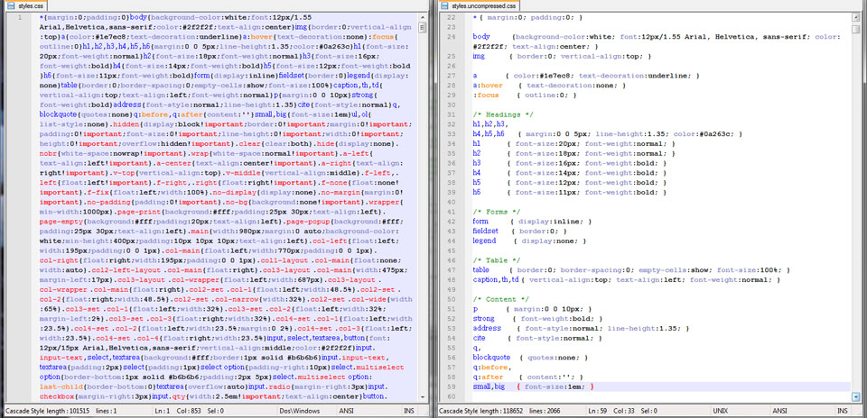
Using JQuery plugins

Slide 14
Integrating JQuery Plugin into MVC/Razor/Html
var items = [
new primitives.orgdiagram.ItemConfig({
id: 0,
parent: null,
title: "Root Project here",
description: "Project Tree",
image: "demo/images/photos/a.png"
}),
new primitives.orgdiagram.ItemConfig({
id: 2,
parent: 0,
title: "Senior Project",
description: "Fabulous",
image: "demo/images/photos/c.png"
})
];
var newItem ;
var items = [ ];
@foreach(var item in Model)
{
@:newItem = new primitives.orgdiagram.ItemConfig({
id: '@(item.ID)',
parent: '@(item.ParentID)',
title: '@(item.Title)',
description: '@(item.Note)'
});
@:if('@item.ParentID' == '0')
@: {@: var headparent = 0 ;
@: newItem.parent = null ;
@: }
@:items.push(newItem);
}

Slide 15
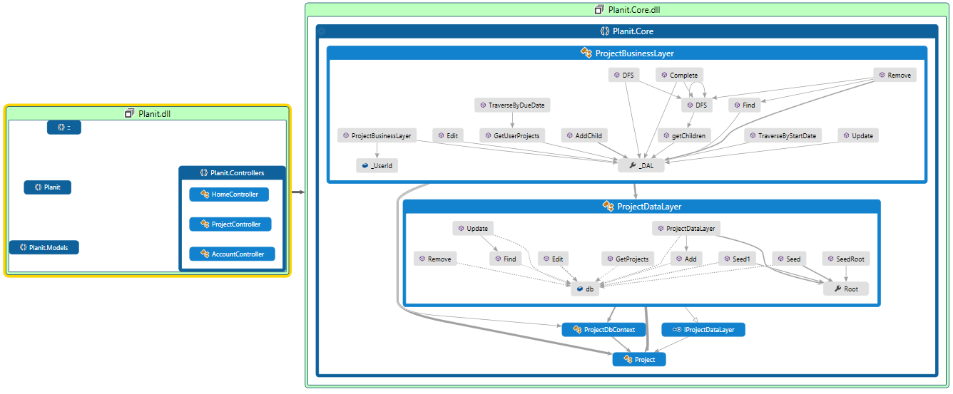
No change is a standalone change

Slide 16
Demo Backlog

Slide 17
What we would do differently
Start implementation sooner.
Waste less time arguing discussing details before we’ve actually implemented anything.
Use backlog tools sooner.
Work hard to prioritize the work effort towards getting functionality before increasing design complexity.

Slide 18
We spent a lot of time upfront, developing a common vision of what we were doing. That early effort sustained us through some of the more challenging decisions.

Slide 19
Planit!
We’re Here to Help
Notes:
We would like to thank you for your time, and this brings us to the conclusion of our presentation. Do we have any questions?

